Slide 1
College Degree Levels
Part 1
College Prep
Mr. Gordon
jgordon@bisdtx.org

Slide 2
Upcoming Events
Weds. Sept. 18- Junior Parent Meeting @ 5:30
Fri. Sept. 20- Student Council Elections
Weds. Sept. 25- BEST College Night @ BHS 7-8:30 PM
hi

Slide 3
College Degree Levels
College degrees are divided into four categories:
Associate Degree
Bachelor’s Degree
Master’s Degree
Doctoral Degree
You will hear these terms used often at CRCA when discussing College and Career.
Today, we will learn about the Associate and Bachelor’s Degrees.
Next week, we will learn about the Master’s and Doctoral Degrees.
hi

Slide 4
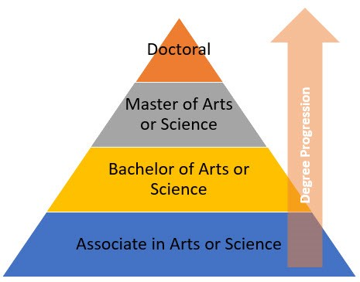
College Degree Levels
hi

Slide 5
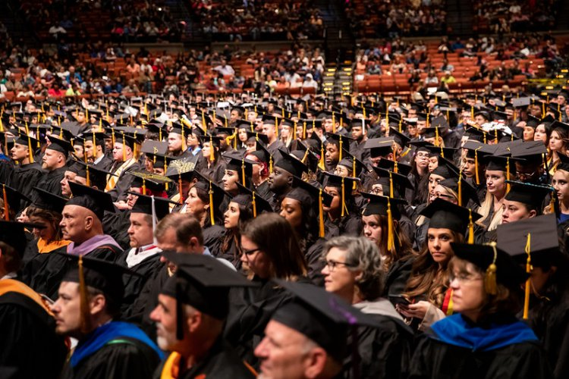
Associate Degree Overview
This is the degree you are currently working towards at ACC.
If you follow the common pathway at CRCA, you will graduate with both a high school diploma and an Associate of Arts in General Studies diploma from Austin Community College.
hi

Slide 6
Associate Degree Overview
Usually takes two years to complete.
Must complete 60 credit hours from a community college.
Examples of community colleges other than ACC:
McLennan Community College in Waco, Alamo Colleges in San Antonio Area, and Houston Community College.
Link for AA General Studies Degree Plan
hi

Slide 7
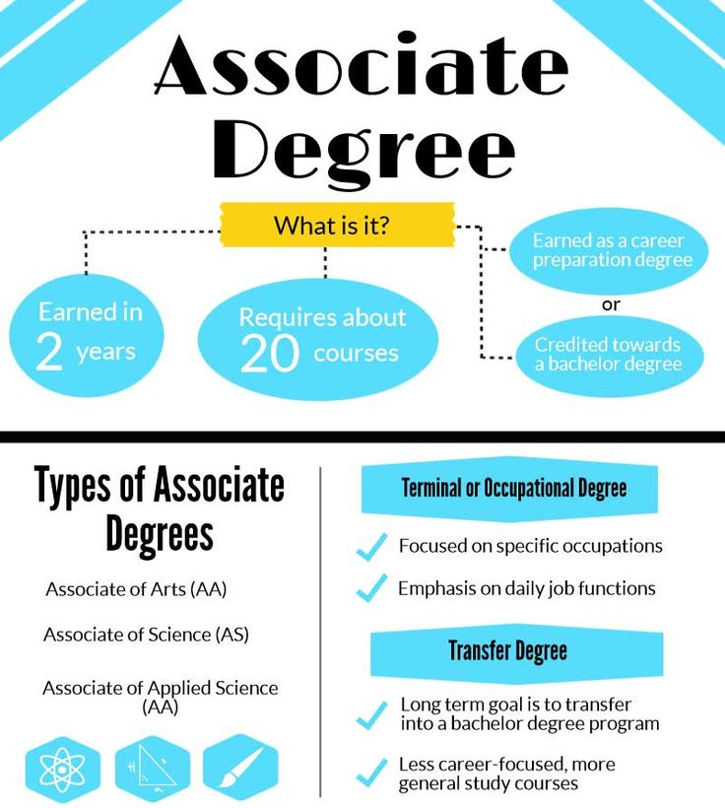
Arrows are the track you are currently on.
Associate Degree
hi

Slide 8
Bachelor’s Degree Overview
A Bachelor’s degree comes after an Associate degree.
Usually takes four years to complete.
Must complete 120 credit hours from a public or private university.
(only 60 hours if you earn your Associate degree first)
hi

Slide 9
Bachelor’s Degree Overview
First two years generally involve general education classes
ie. English, History, Government
And introductory classes for a student’s major.
During the next two years, students take advanced classes in their major.
Depending on the career, a Bachelor’s degree may be all that you need.
hi

Slide 10
hi

Slide 11
Today’s College Prep Assignment
In the comments section of today’s College Prep,
answer the following question:
How many college credit hours will you have
by the time you graduate from CRCA?
hi

